Slide 1



A Project On Food Delivery System Partner App : Foodies

Slide 2
Submitted in partial fulfilment of the requirements of the degree of
BACHELOR OF TECHNOLOGY
Submitted by
Palak Agarwal (Roll No - 20ETCCS081)
Pushkar Suthar (Roll No - 20ETCCS094)
Manav Tailor (Roll No - 20ETCCS070)
Bhanupratap Ahir (Roll No - 20ETCCS015)
Jaideep Kumawat (Roll No - 20ETCCS055)
Gagan Jain (Roll No - 20ETCCS039)

Slide 3
COMPUTER SCIENCE DEPARTMENT
TECHNO INDIA NJR INSTITUTE OF TECHNOLOGY, UDAIPUR MAY 2024

Slide 4
GROUP NAME: The Developers
FOOD DELIVERY SYSTEM – Foodies Partner Application

Slide 5
PROBLEM STATEMENT
The current food delivery landscape lacks an efficient platform for restaurant owners seamlessly handle all there business needs in one place. The restaurant owners right now have to manually handle the inventory separately as well as the existing platforms provides a very complex interface resulting in problems with orders management, expenses tracking, and menu handling. Our platforms solves these problems efficiently by providing a very simple user experience resulting in effortless management of all restaurant needs in one place.

Slide 6
OBJECTIVE AND SCOPE OF PROJECT
The project aims to develop a user-friendly web platform that enables the restaurant owners to easily handle all there operational activities in one place. The system will facilitate registration, profile creation, order management, menu management, inventory management, promotions management. The scope includes a secure login system, real-time notifications about incoming orders, and inventory tracking mechanisms for restaurant owners.
Objective:
Enhance food delivery systems by providing restaurant owners with an all-in-one platform to manage all their operational activities in one place for efficient working of the restaurant.
Scope:
Redesign and augment existing platforms to incorporate inventory management feature and, better and simpler platform for order tracking and promotion creation. Conduct thorough testing for effectiveness and user-friendliness, with the ultimate goal of creating a more helpful and satisfying restaurant management experience.

Slide 7

METHODOLOGY
Creating a food Partner system involves various functionalities to ensure a seamless experience for restaurant owners. Here are essential features and functionalities you may want to consider:
1. User Registration and Authentication:
2. Orders:
3. Inventory
4. Menu
5. Promotions
6. Real-Time Orders Updates
7. Synchronized Menu and Inventory
8. User information

Slide 8
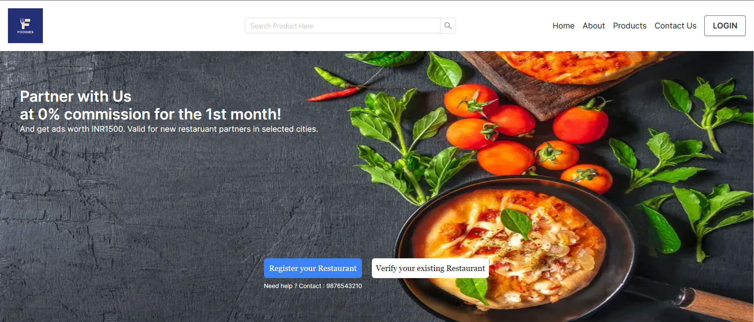
Home Page :-
HARDWARE:
Laptop: Basic Requirement –
Windows 10/11,GarudaLinux, i5,i7 11gen processor, 5gb Memory space, 8gb to 16gb RAM
Internet Facilities.
SOFTWARE:
Frontend: Javascript/TypeScript, React.JS/Next.JS, Ant-Design
Backend: GraphQL, Node.JS, Express.JS, ORM,PostgreSql as Database
APIs: Google Maps for location services, Payment Gateway, Rapid Api
Development Tools: VS Code, Git for version control, ThunderClient/Postman for API testing

Slide 9
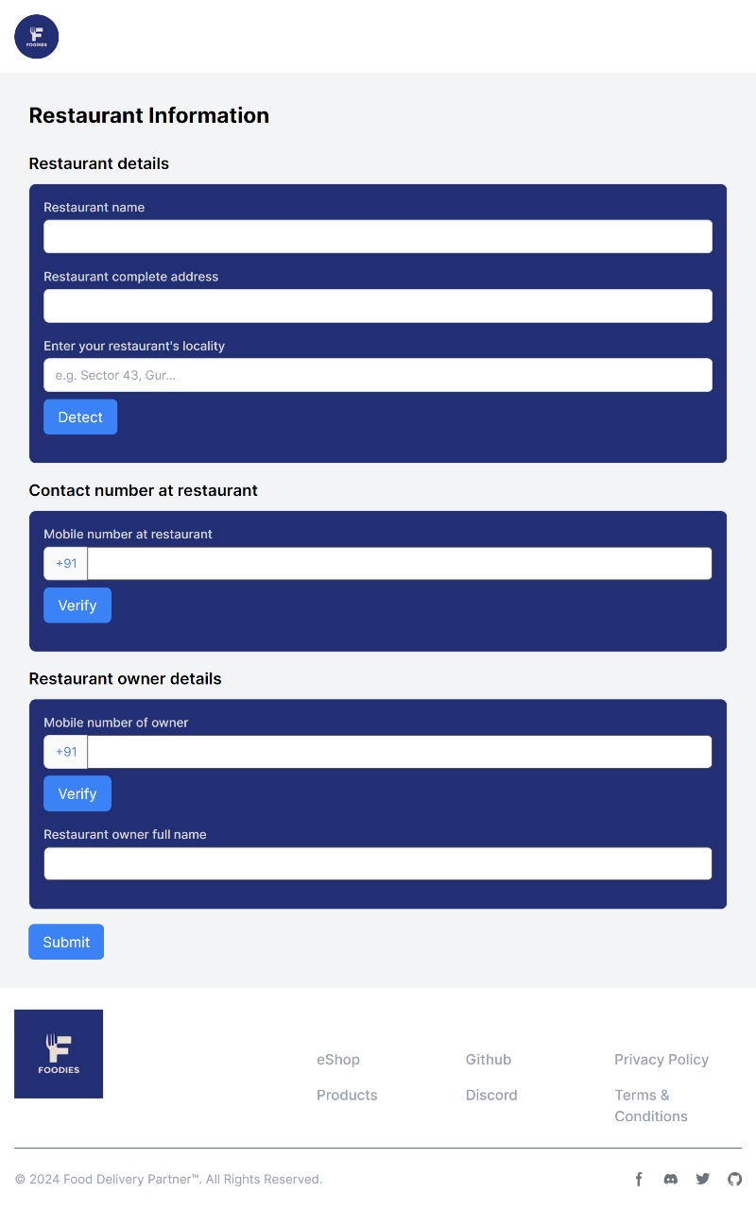
Registration Page :-

Slide 10
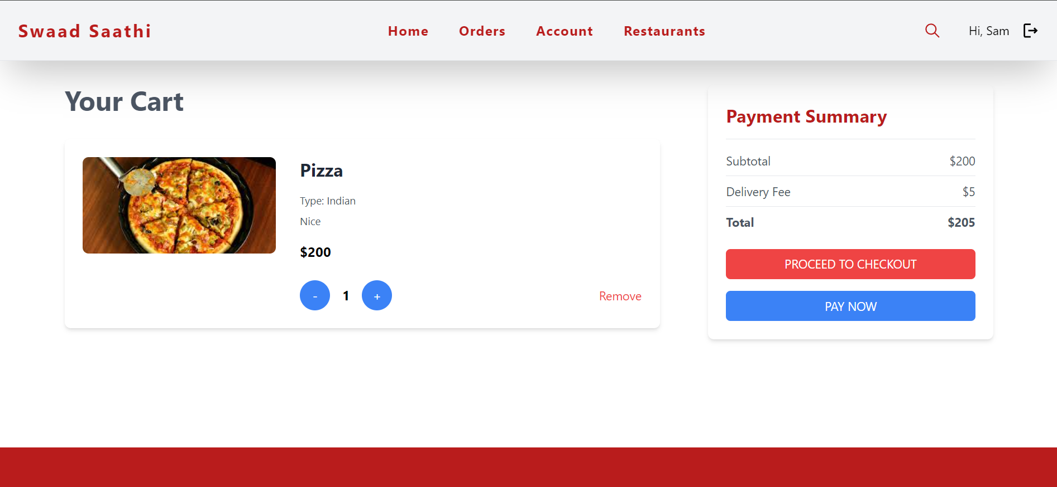
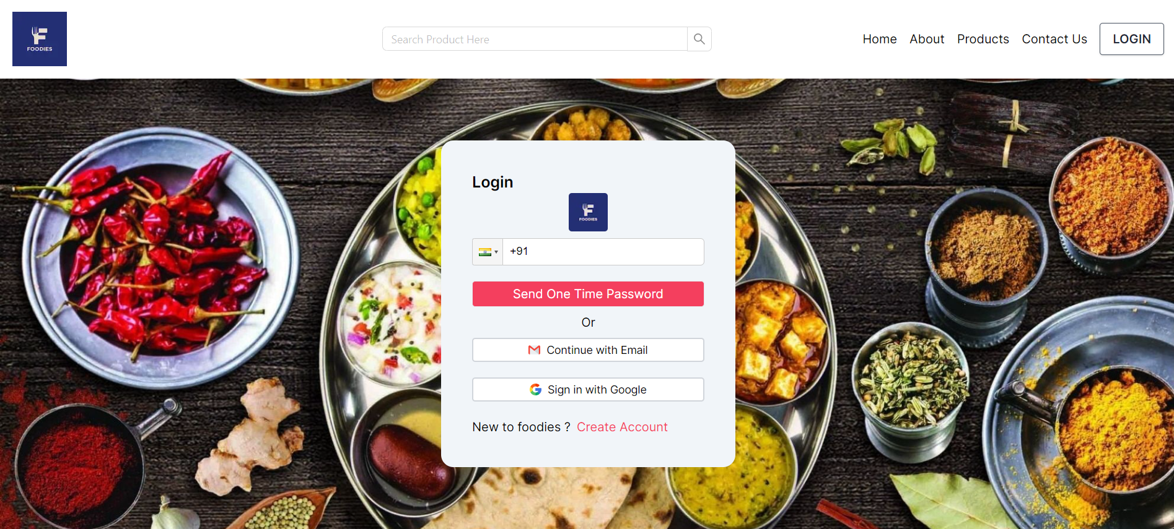
Login page: -

Slide 11
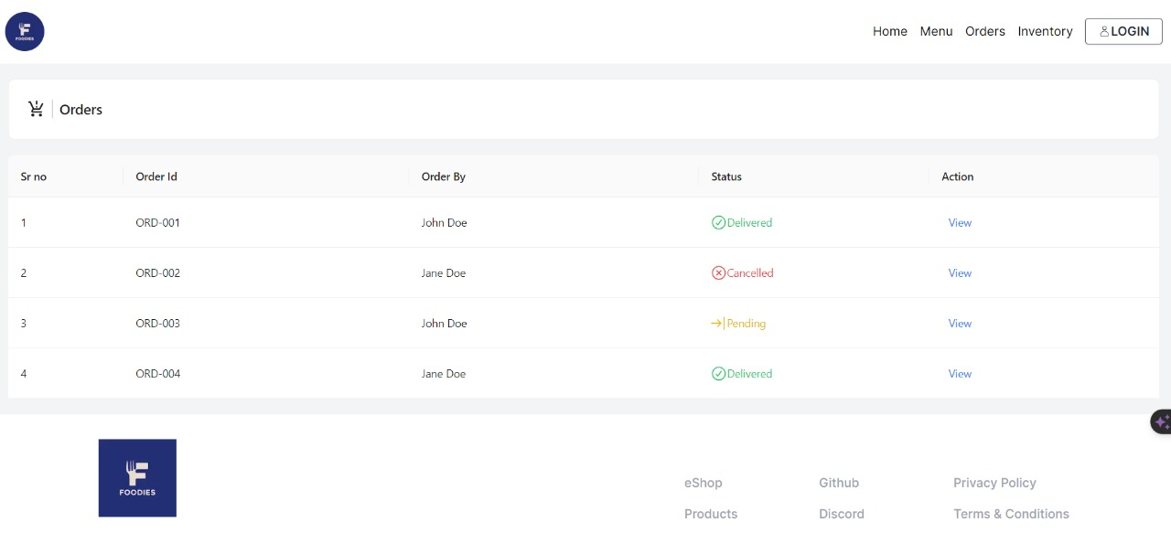
Orders Page :-

Slide 12
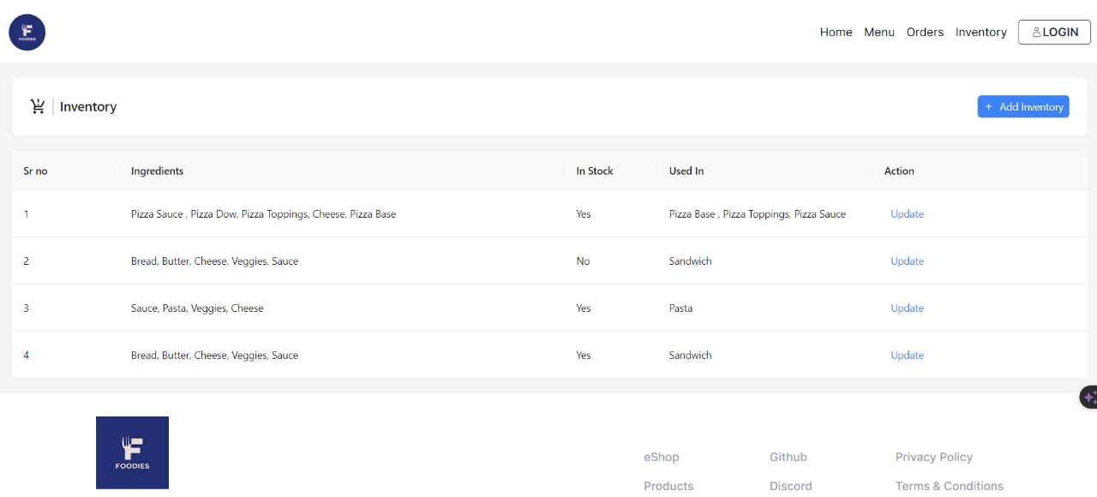
Inventory Page :-

Slide 13
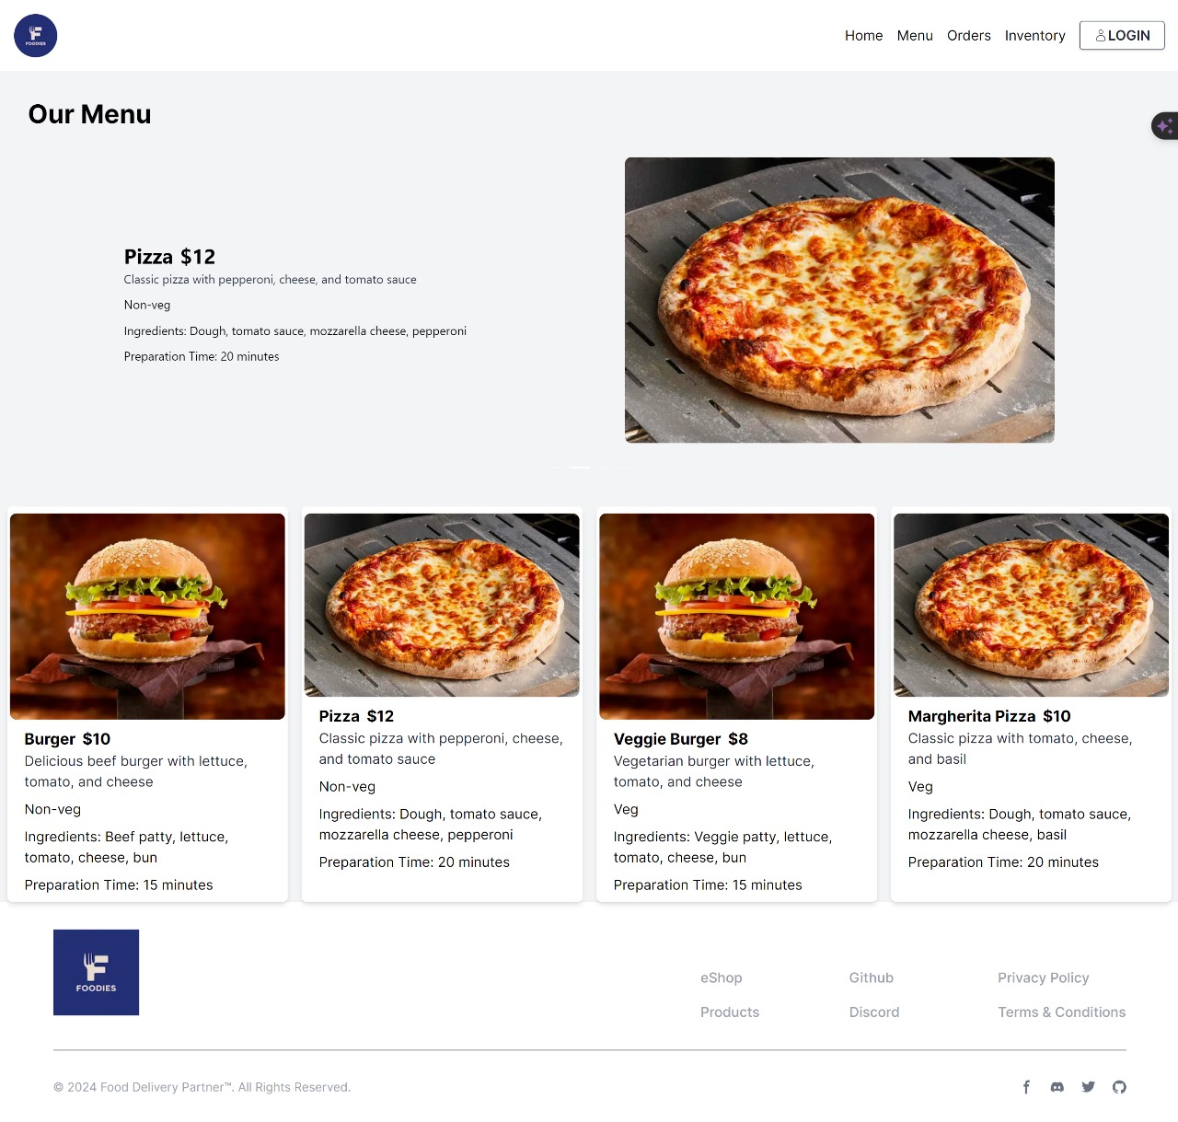
Menu Page :-

Slide 14
APPLICATION & FUTURE SCOPE OF PROJECT
1.Improved Customer Experience
2.Enhanced Operational Efficiency
3.Increased Transparency
4.Data Insights
5.Personalized Recommendations
6.Dynamic Pricing
7.Enhanced Marketing Opportunities

Slide 15
PROJECT TIMELINE
Project Initiation
2 weeks
Requirement Analysis and Planning
1 week
Competitor Analysis
1 week
Technology Assessment and Selection
2 weeks
User Interface Design
3 weeks
Backend Development
3 weeks
Integration with Restaurants
2 weeks
Testing and Quality Assurance
1 week
User Education and Communication
2 weeks
Launch and Monitoring
2 weeks
Continuous Improvement
1 week

Slide 16
REFERENCES / BIBLIOGRAPHY
Rest API Documentation
TypeScript Documentation
ORM Documentation
Node.js Documentation
Next.js Documentation
React.js Documentation
Google Maps Platform Documentation
PostgreSql Documentation

